Slide 1
Practical LaTeX # 20
WPG
Stretchable Horizontal Lines

Slide 2
Stretchable Horizontal Lines
WPG
There are three stretchable horizontal lines
Braces
Bars
Arrows
These can appear above or below the formula.

Slide 3


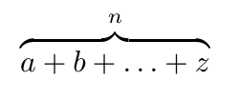



Horizontal Braces
WPG
\overbrace, adds the brace over the formula
\underbrace, adds the brace under the formula

Slide 4



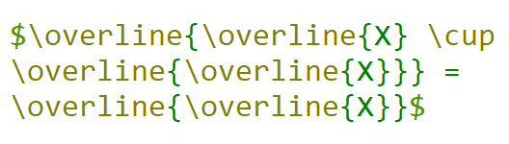

Horizontal Lines/Bars
WPG
\overline, adds the line/bar over the formula
\underline, adds the line/bar under the formula

Slide 5
Horizontal Arrows
WPG
\overleftarrow, adds the left arrow over the formula
\overrightarrow, adds the right arrow over the formula
\overleftrightarrow, adds the left and right arrow over the formula
\underleftarrow, adds the left arrow under the formula
\underrightarrow, adds the right arrow under the formula
\underleftrightarrow, adds the left and right arrow over the formula

Slide 6


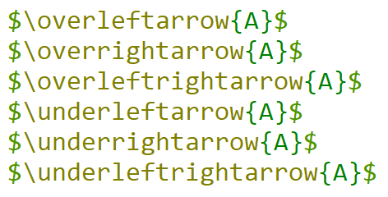
Horizontal Arrows
WPG

Slide 7
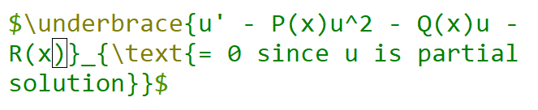
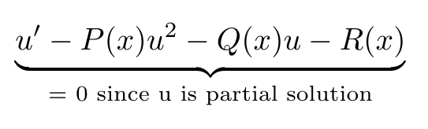
Example
WPG

Slide 8




WP Galaxy
WPG
Follow on
Join Facebook WPG Latex Learning Group
https://www.facebook.com/groups/744709572836598
twitter.com/017FastAbuzar
www.linkedin.com/in/abuzarghafari
https://github.com/AbuzarGhafari
Like, Comment, Share and Subscribe the Channel

Slide 9

WP Galaxy
WPG

